Slide 1
PDF GENIE
BATCH – 11
Date: 12.05.2025
Presented by ,
Mehar Jabeen N(812821104040)
Kalaiselvi S(812821104029)
Kaviya C(812821104032)
Supervised by ,
Mrs. P .Sigappi
AP/CSE

Slide 2
ABSTRACT
This offline tool helps users understand complex PDF documents like research papers, contracts, and manuals. It extracts important content—including text, tables, and code—and turns it into searchable data using AI. Users can upload PDFs and ask questions through a simple web interface, getting accurate answers with sources. The system runs locally, protects privacy, and works well without internet, making it ideal for schools, law firms, and technical teams.

Slide 3
OBJECTIVE
Processing diverse types of documents (academic, legal, technical)
Extracting meaningful content, including structured data like tables and code
Enabling natural language querying
Supporting data privacy, air-gapped systems, and zero-internet environments

Slide 4
EXISTING SYSTEM
🔹 1. Humata.ai
Upload PDFs and ask questions in natural language
Auto-summarizes, explains, and cites answers
Best for: Research papers, reports, legal docs
🔹 2. ChatPDF
Simple UI: Drop in a PDF and chat with it
Free tier available, supports multiple languages
Best for: Quick Q&A over casual documents
🔹 3. AskYourPDF
PDF chatbot powered by OpenAI or custom LLMs
Browser extension and file history support
Best for: Repeated queries over large files

Slide 5
LIMITATIONS OF EXISTING SYSTEM
Dependence on Cloud APIs: Most RAG systems rely on OpenAI or other hosted LLM APIs, unsuitable for secure/offline environments.
Limited PDF Parsing: Many systems extract plain text without preserving tables, code snippets, or citation context.

Slide 6
PROPOSED SYSTEM
Offline RAG Framework: Uses FAISS and SentenceTransformers to eliminate internet dependency.
Enhanced PDF Parsing: Utilizes PyMuPDF and pdfplumber to accurately extract complex structures like tables, diagrams, and code.
Semantic Chunking: Splits documents into overlapping chunks to preserve context, with tagging for content type (citation, table, etc.).
Modular Architecture: Each component (PDF loader, chunker, embedder, retriever, UI) is independently extensible.
User Interface: Simple Streamlit front-end allowing document upload and conversational interaction.
Error Handling & Validation: Captures edge cases like invalid PDFs, empty documents, or irrelevant queries.

Slide 7
ADVANTAGES OF PROPOSED SYSTEM
Smart Retrieval – Uses semantic search for accurate, context-aware results.
Handles Complex PDFs – Supports academic, legal, and technical documents.
Contextual Answers – Generates answers grounded in the document content.
Offline Functionality – Works without internet, ensuring data privacy.
Modular Design – Easy to maintain, upgrade, and debug.
Scalable – Easily extendable to other models, formats, or databases.
User-Friendly – Simplifies access to complex information via natural language.
Secure – No external API or cloud use—ideal for sensitive content.

Slide 8
SYSTEM ARCHITECTURE

Slide 10
LIST OF MODULES
Module Name | Purpose | Core Functionality
pdf_loader.py | Load and parse PDF content | Uses PyMuPDF and pdfplumber to extract raw text, tables, and metadata
chunker.py | Breaks long text into semantic chunks | Applies overlap strategy to ensure question context is preserved
embedder.py | Embeds text using local models | Uses SentenceTransformers (MiniLM) for vectorization
vector_store.py | Stores and searches vector data | Uses FAISS to index and retrieve document chunks
rag_pipeline.py | Integrates all backend components | Builds knowledge base and processes user queries with retrieval + answer synthesis
interface.py | Handles user input/output | Streamlit UI for PDF upload and question answering
helpers.py | Common utility functions | Validates inputs, formats responses, manages errors
app.py | Entry point of the application | Runs the Streamlit app
requirements.txt | Dependency list | Contains all required packages for installation
README.md | Project documentation | Explains setup, usage, and system requirements

Slide 11
SCREENSHOTS

Slide 12
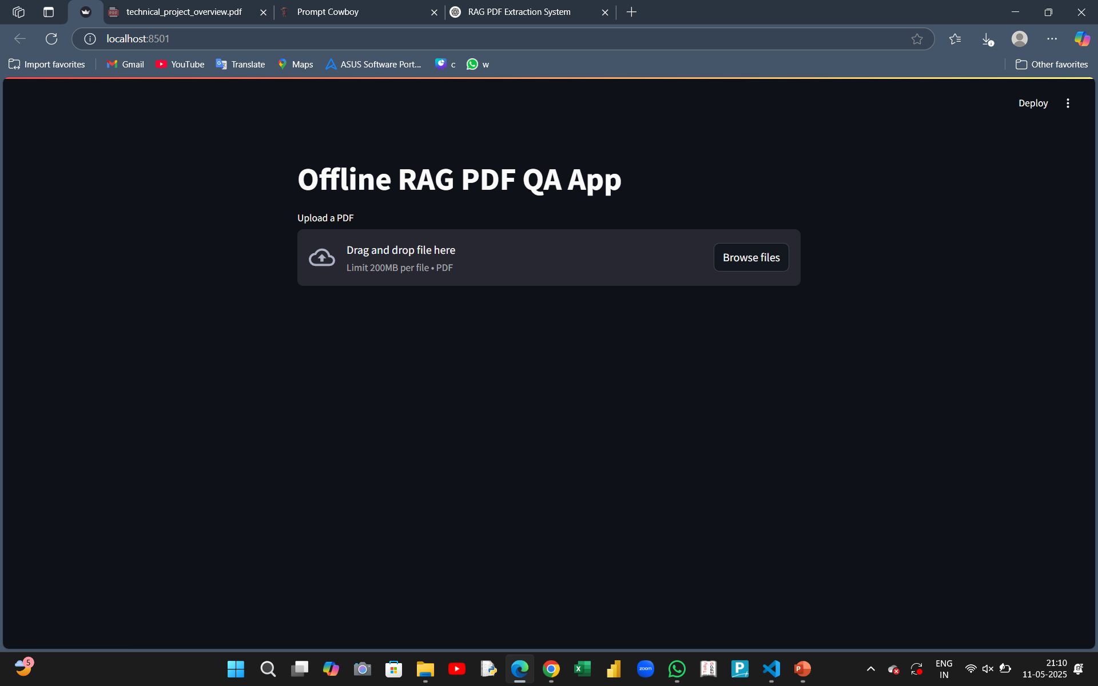

Slide 13
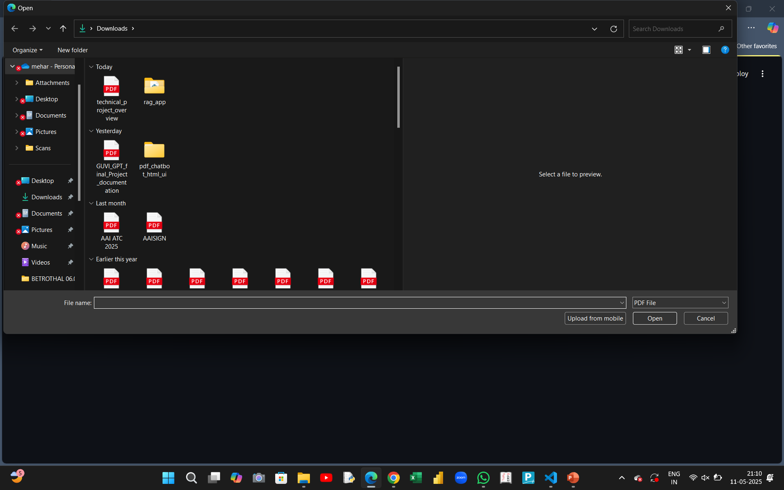

Slide 14
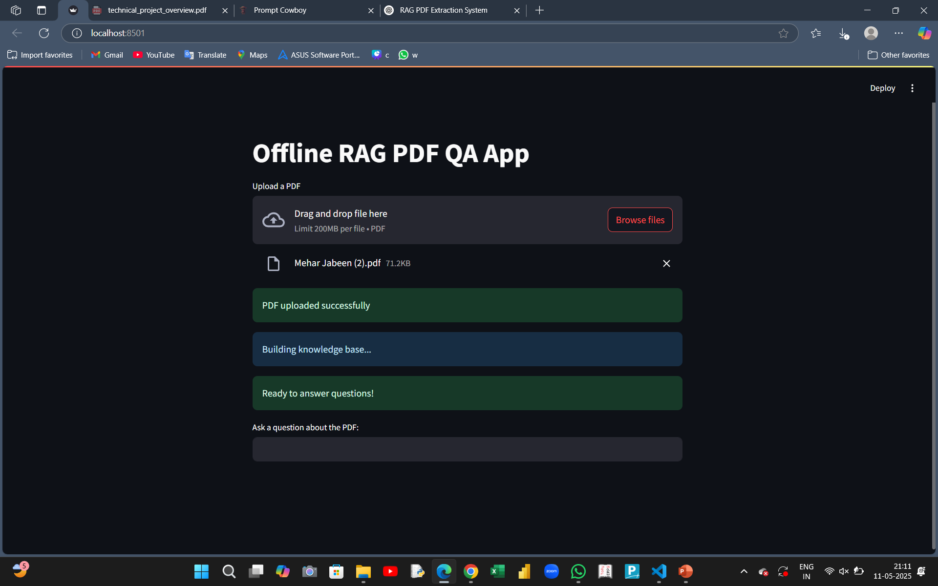

Slide 15
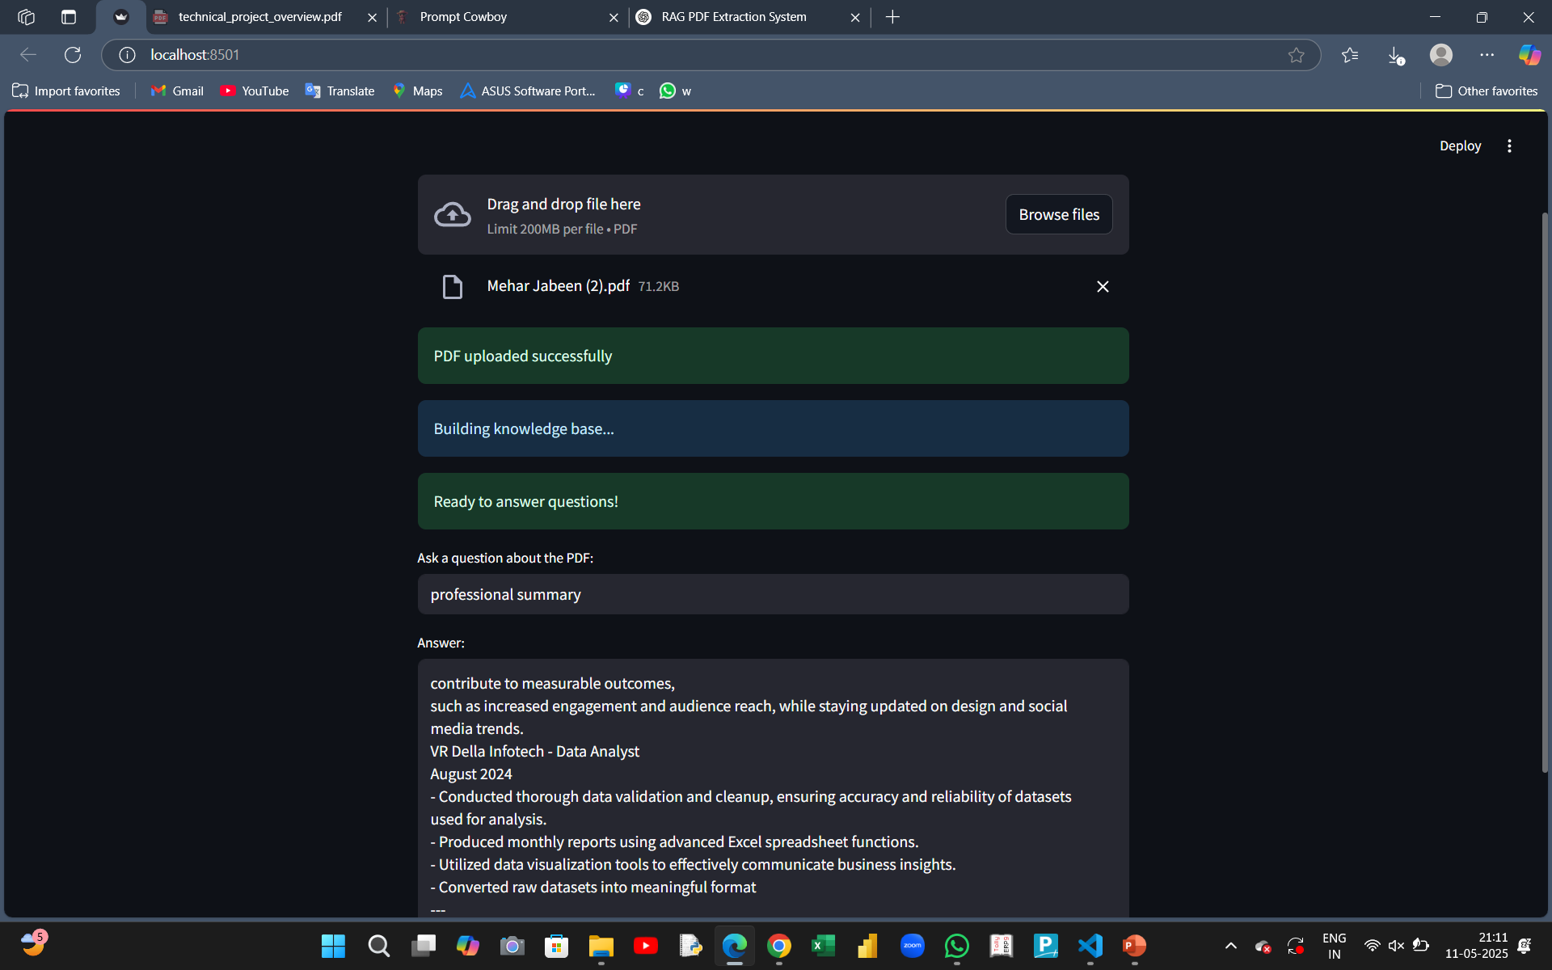

Slide 16
Conclusion
The proposed Retrieval-Augmented Generation (RAG) system offers a robust, offline solution for extracting meaningful insights from complex PDF documents, including academic papers, legal contracts, and technical manuals. By combining advanced text processing, semantic embeddings, and natural language generation, the system enables users to interact with documents intelligently and efficiently. Its modular architecture, offline capability, and emphasis on accuracy, usability, and security make it a practical and scalable tool for real-world deployment. This solution significantly enhances information accessibility while preserving document context and reliability.

Slide 17


